Slide 1
WEB SCRAPING & AUTO POST

Slide 2
Working
This scraping process works by using the ‘PRAW’ module to get the access to the Reddit API, through which we get the Client ID and Secret ID for the test project.
Then a subreddit is selected from which the data is to be scraped.
The script downloads and evaluates these images, ensuring their uniqueness by comparing them against a collection of previously ignored images stored in a designated folder.
After processing all relevant posts, the script synthesizes this accumulated data into a Pandas DataFrame, subsequently exporting it as a CSV file.
This CSV file serves as a comprehensive repository, documenting the top posts alongside their corresponding image URLs, facilitating easy access and further analysis.

Slide 3
WORKING (CONTD.)
This Python script leverages the Selenium and PyAutoGUI libraries to orchestrate an automated Instagram posting sequence. Upon initiation, it opens a Chrome web browser and navigates to the Instagram login page
The script's login_to_instagram function employs WebDriver's explicit waits to locate & interact with the login elements- username and password, entering the provided credentials and executing the login action.
Once successfully logged in, the script proceeds to iterate through a CSV file containing post details, including captions and image names. For each row in the CSV file, the create_post function is invoked. This function simulates user actions by clicking the "New post" button, emulating file selection via PyAutoGUI to upload an image, appending a caption, and ultimately sharing the post on Instagram.
After each post, the script calculates the elapsed time and strategically pauses for a predetermined duration (at least 1800 seconds or 30 minutes in this case) before proceeding to the subsequent post. Finally, upon completing the entire posting sequence, the script gracefully closes the browser session, concluding the automation process.

Slide 4
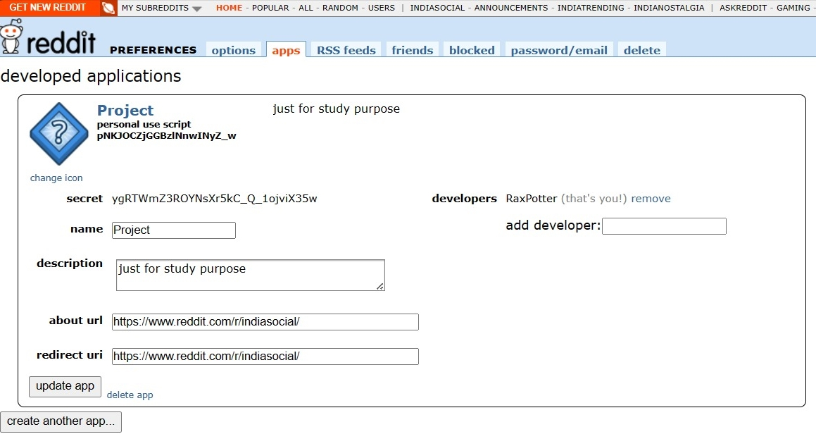
REDDIT API

Slide 5
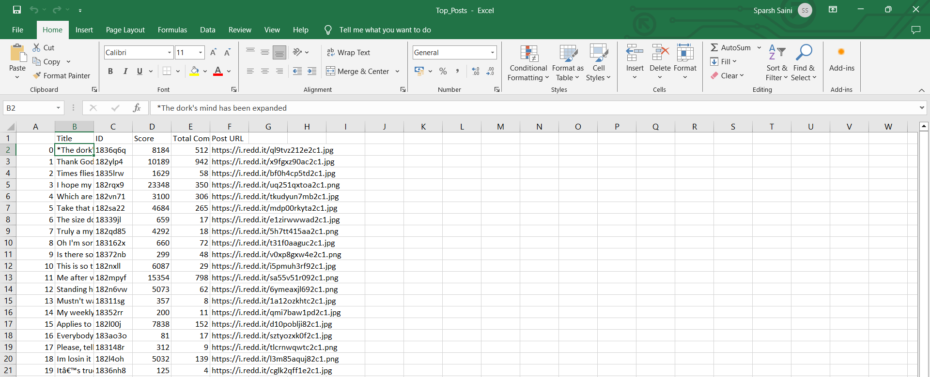
Scraped data record in .csv file
C:\Users\spars\Documents\Top_Posts.csv

Slide 6
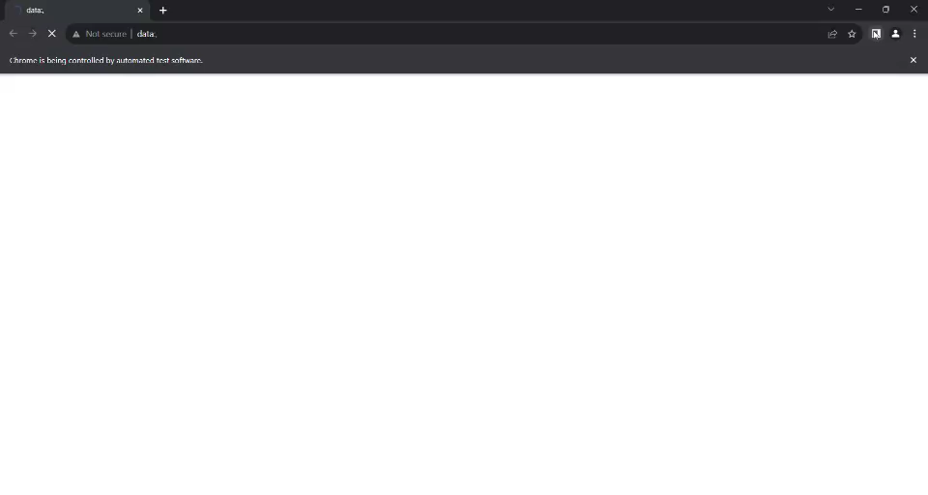
AUTO POST

Slide 7
APPLICATIONS
Price Monitoring and Comparison.
Social Media Monitoring.
Data Collection for Research.
Scheduled Content.
Marketing Campaigns.
User Engagement Strategies.
Time Management.

Slide 8
THANK YOU.

